Slide 1



Grainger – Vision+
Tenant & Agent Journey V1.1

Slide 2

Tenant and Agent Journey Overview
Grainger Portal
Grainger Salesforce
Vision+ API
Vision+ Tenant Portal
Vision+ Agent Portal
1a. Additional Applicants added
1.b Tenant makes advance payment
2. Reference instigated
3. TenancyID and ApplicantID returned to Salesforce
Time delay
6. Query applicant ID + applicant secret
4. Additional applicants added to reference
7. Applicant ID + applicant secret returned
5. Applicant ID’s returned to Salesforce
8. Query jwt with applicant secret and client id
PIB Auth Server
9.Jwt Token return
10. Applicant(s) access portal via iFrame and Jwt Token
11. Referencing process
In progress
12. Vision+ updates Salesforce on reference Status change
i) Agent goes to Vision+ portal for review
Ii)SAML request sent to Salesforce Identity Provider
iii) SAML assertion sent to Vision+ Agent Portal to allow user access

Slide 3
1. Reference instigated
Grainger Systems
1. Reference instigated
Vision+ API
Request: CreateReferenceWithApplicantIframe
{
"agentCode": "9999", | agentCode
"rentGuarantee": 1, | rentGuarantee
"tenancyTermMonths": 12, | tenancyTermMonths
"monthlyRental": 2000, | monthlyRental
"lettingType": 1, | lettingType
"estimatedMoveInDate": "2023-04-01T10:55:02.383Z", | estimatedMoveInDate
"propertyType": 1, | propertyType
"isAdvanceRent": false, | isAdvanceRent
"propertyAddress": {
"houseNumber": "65000", | houseNumber
"houseName": "Oxford Street", | houseName
"addressLine1": "Gadlys", | addressLine1
"addressLine2": "Parkway", | addressLine2
"town": "Aberdare", | town
"postcode": "CF44 8BE", | postcode
"ukCountryCode": 3 | ukCountryCode
},
"tenants": [
{
"tenantTypeId": 1, | tenantTypeId
"referenceType": 1, | referenceType
"rightToRent": true, | rightToRent
"title": 1, | title
"otherTitle": "", | otherTitle
"firstName": "Berty", | firstName
"middleName": "Boo", | middleName
"surname": "Basset", | surname
"shareOfRent": 600, | shareOfRent
"telephoneCountryID": 2, | telephoneCountryID
"contactTelephoneNo": "01234567891", | contactTelephoneNo
"emailAddress": "test@testtesttest.test" | emailAddress
}
]
}
Response
{
"success": true,
"payload": {
"agentCode": "9999",
"propertyTenancyId": 85670,
"ReferencingApplicantList": [
{
"applicantID": 678007,
"applicantName": "Mr Berty Boo Basset"
"applicantSecretKey: "0982109380193280918320918"
}
]
},
"message": "Applicant link sent successfully."
}

Slide 4
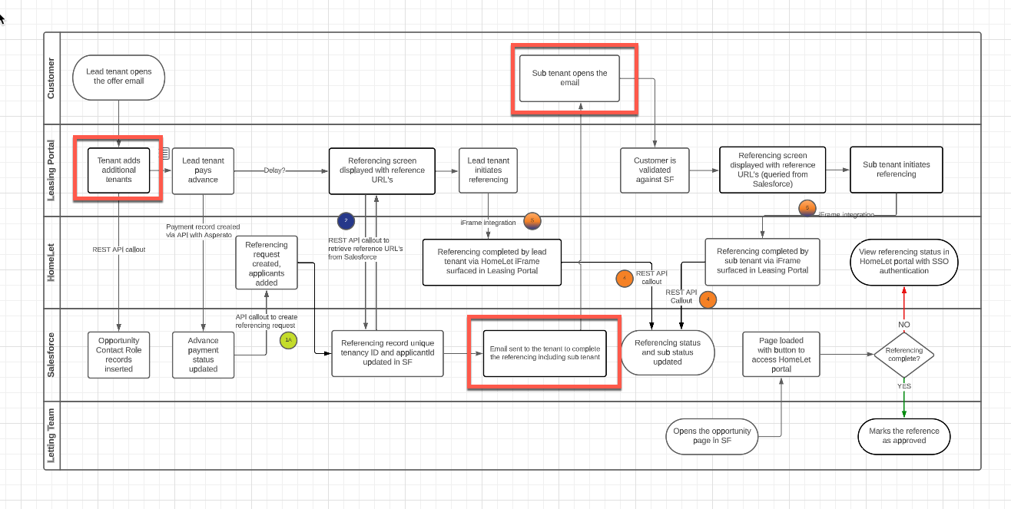
1.a Additional Applicants added
Grainger Systems
1.a Additional Applicants added
Vision+ API
Request: AddApplicantToTenancyWithIframe
{
"agentCode": "string",
"propertyTenancyId": 989898,
"isSentTenantLink": true,
"linkedApplicantID": [9999],
"tenantTypeId": 1,
"referenceType": 1,
"rightToRent": true,
"title": 1,
"otherTitle": "string",
"firstName": "string",
"middleName": "string",
"surname": "string",
"shareOfRent": 0,
"telephoneCountryID": 1,
"contactTelephoneNo": "string",
"emailAddress": "string"
}
}
Response
{
"success": true,
"payload": {
"agentCode": "99999",
"propertyTenancyId": 87812,
"ReferencingApplicantList": [
{
"applicantID": 679755,
"applicantName": "Mr Billy Bob"
"applicantSecretKey: "0982109380193280918320918"
}
]
},
"message": "Applicant link sent successfully."
}

Slide 5
2. Applicant(s) access portal via iframe
2. Applicant(s) access portal via iframe
1
2
3
4
5
Grainger Systems
Vision+ Portal
Vision+ API called from Grainger Salesforce to create tenancy with input from applicant
Or
Vision+ API called from Grainger Salesforce to add applicant to tenancy with input from applicant
Vision+ API responds with Applicant Secret Key, PropertyTenancyId & ApplicantID, stored in salesforce. Agent setting in Vision+ supresses email send
Grainger Portal (Codification) will call pib auth server to generate token with client id and application secret key.
(https://preprod-auth-service.letalliance.dev)
Grainger Portal (Codification) will load tenant portal in iframe using token return by auth server.
(https://preprod-tenant.letalliance.dev/externalreference)
Vision+ will use the token and extract user data with client id as Grainger.

Slide 6
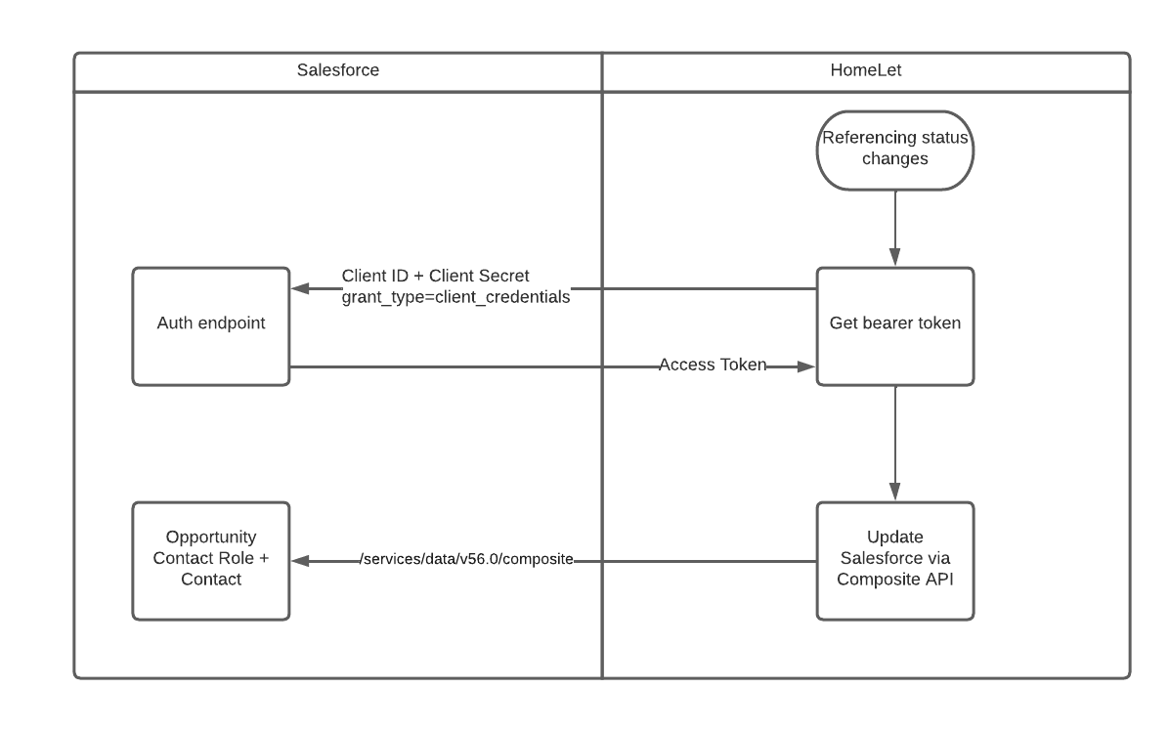
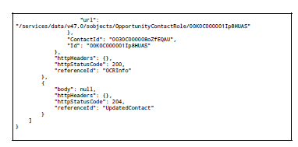
3a. Vision+ updates Grainger on reference Status change
3. Vision+ updates Grainger on reference Status change
Grainger Salesforce
Vision+ API
HomeLet to call in to Salesforce using the composite API, using propertyTenancyId and applicantId to identify the record in Salesforce.
Open Box to support integration delivery by providing details with Postman collection covering:
authorize -> Bearer token
POST -> OpportunityContactRole & Contact
  Applicant’s ‘Current Address’ to be returned (on Contact / Person Account)
    Contact.MailingStreet, Contact.MailingCity, Contact.MailingState, Contact.MailingPostalCode, Contact.MailingCountry
  Applicant’s ‘Outcome Status’ and ‘Referencing Status’ to be returned (near real time)
    OpportunityContactRole.Reference_Check_Status__c​ (Picklist):
      Incomplete / Awaiting Details / In Progress / Complete / Approve / Awaiting Review / Deleted
    OpportunityContactRole.Referencing_Outcome__c (Picklist):
      Acceptable / Guarantor Required / Incomplete / Not Acceptable

Slide 7
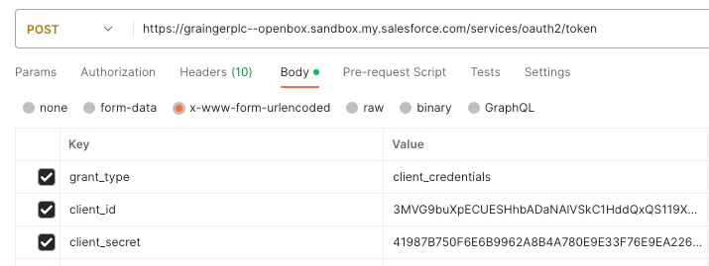
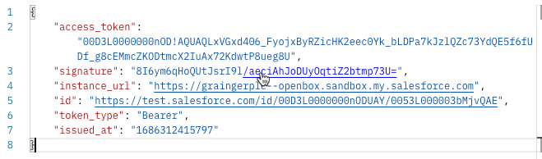
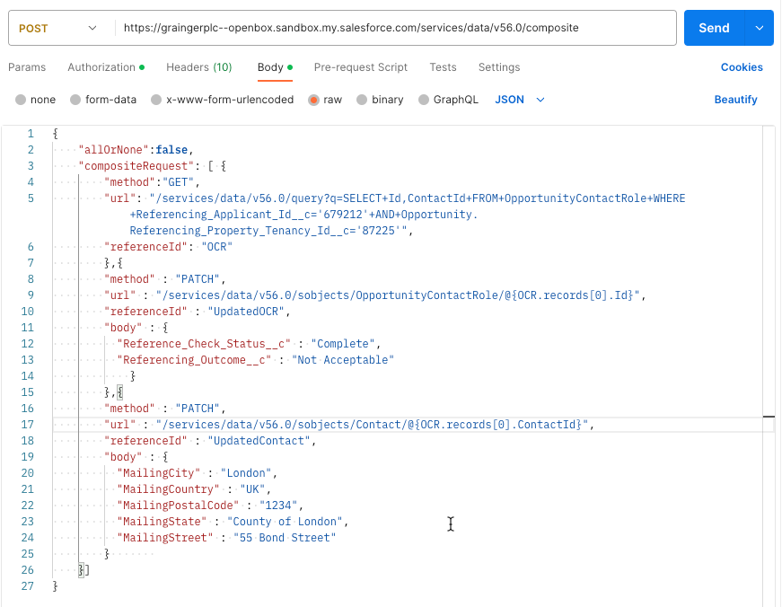
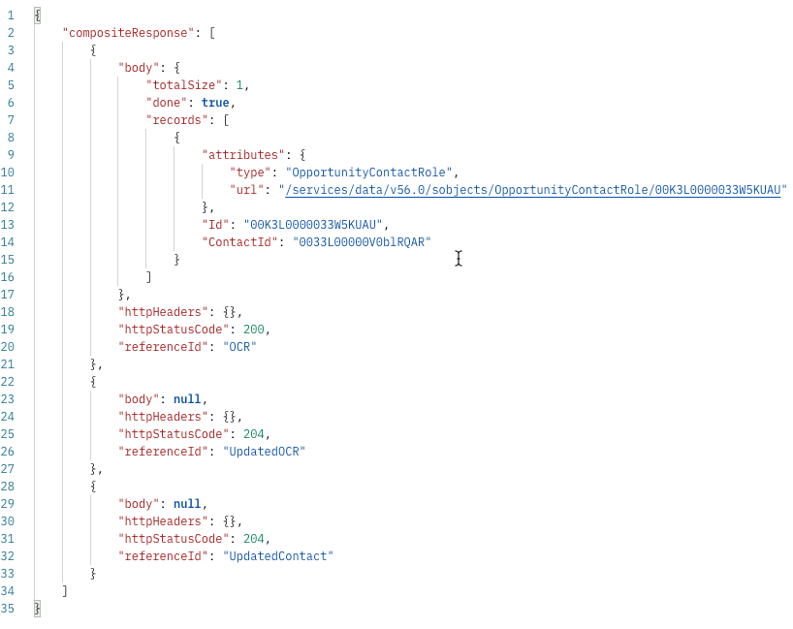
3b. Vision+ updates Grainger on reference Status change
3. Vision+ updates Grainger on reference Status change
Grainger Salesforce
Vision+ API
Access Token Request using Client Credentials Flow
Instance URL
Returns
Client ID
Client Secret
Update OpportunityContactRole status and Contact address
Instance URL
ApplicantId
PropertyTenancyId
Returns
ReferenceStatus
OutcomeStatus
Contact address details

Slide 8
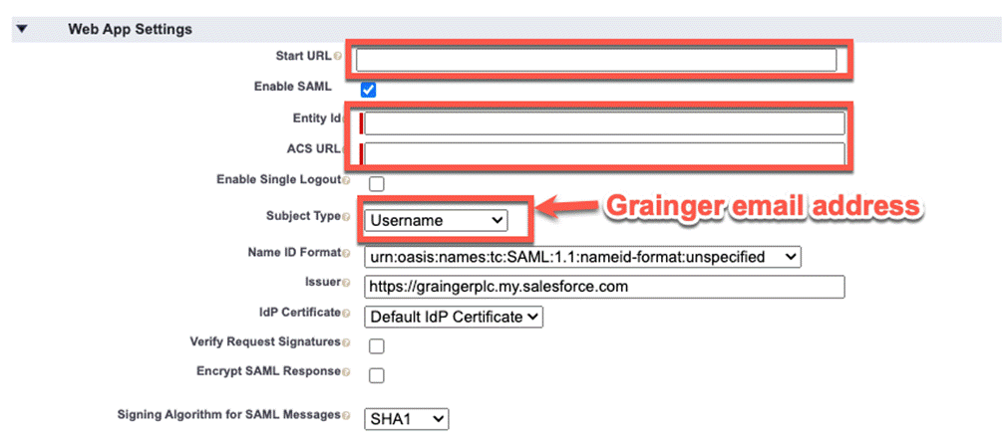
4. Agent goes to Vision+ portal for review
4. Agent goes to Vision+ portal for review
Grainger Systems
Vision+ Portal
1
2
3
4
5
Agent has a Salesforce user and is authenticated in Salesforce
Salesforce user clicks Vision+ button to open a new tab with Vision+ Portal URL
Vision+ makes SAML request to Salesforce identity provider
Salesforce responds SAML assertion confirming identity of Salesforce user (Salesforce username to be used as unique identifier)
Vision+ Agent facing Portal logs user in (Vision+ portal user must already exist and is identified by Grainger Salesforce username)
Vision+ decrypts and decodes JWT Token, validates applicant and starts tenant facing journey in iframe

Slide 9
Vision+ Mandatory Fields in discussion
Property | Mandatory in Vision+ | Impact of incorrect/default data | Issue | Agreed Action
propertyType | Yes, enum lookup | Lower, impacts reporting | Data not currently available in Grainger Salesforce | Grainger will map between systems but use “other” in the meantime. No impact to dev work on Vision+.
propertyConstructionPeriod | Yes, enum lookup | Lower, impacts reporting | Data not currently available in Grainger Salesforce | Set to Non mandatory in new API call
numberOfBedrooms | Yes, integer | Lower, impacts reporting | Data not currently recorded in Grainger | Set to Non mandatory in new API call
noOfAdultOccupants | Yes, integer | High, impacts referencing chance | Data not currently recorded in Grainger | Recommend using tenant count, Set to Non mandatory in new API call.
noOfChildOccupants | Yes, integer | Lower, impacts reporting | Data not currently recorded in Grainger | Set to Non mandatory in new API call
Applicant
title | Yes, enum lookup | High, impacts referencing chance | Data not currently mandatory in Grainger, not always recorded | Grainger to amend system to provide title. Confirmed that Tenant has the ability to amend details in first screen of iframe
telephoneCountryID | Yes, enum lookup | High, impacts referencing chance | Data not currently recorded in Grainger, Telephone number is free text and can have country code or not | Confirmed that Tenant has the ability to amend details in first screen of iframe

Slide 10
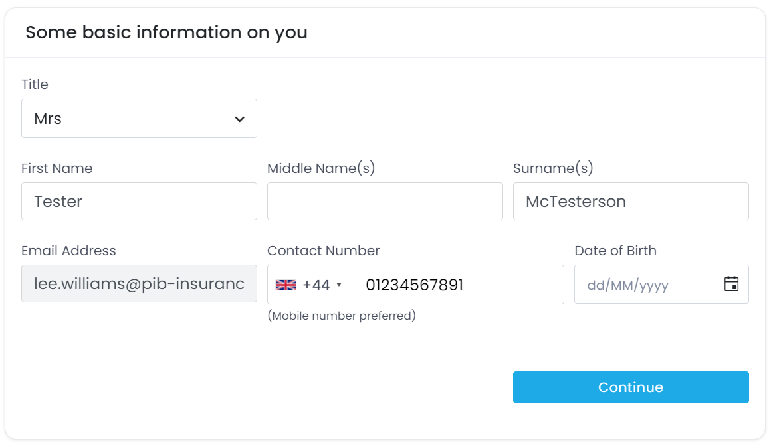

Slide 11
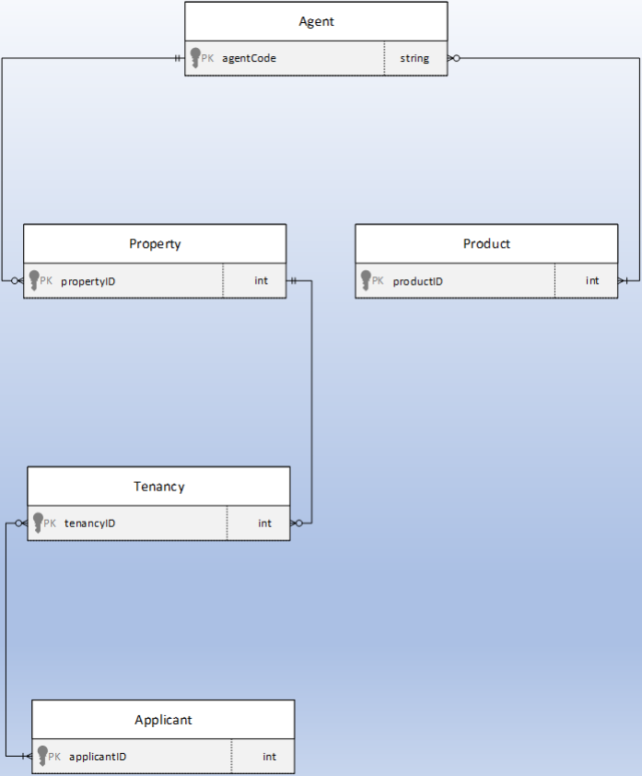
Vision+ /Grainger Identity mapping
Vision+ Grainger
agentID
264020 (Grainger)
propertyTenancyId
Opportunity
Referencing_Property_Tenancy_Id__c
OpportunityContactRole
Referencing_Applicant_Id__c
Applicant ID
Applicant ID
OpportunityContactRole
Referencing_Applicant_Id__c
OpportunityContactRole
Referencing_Applicant_Id__c
Applicant ID
On create reference call or add applicant, the IDs are returned from Vision+ and stored in salesforce. These are synonymous data points with their equivalent in salesforce and other Grainger systems

